Slide 1
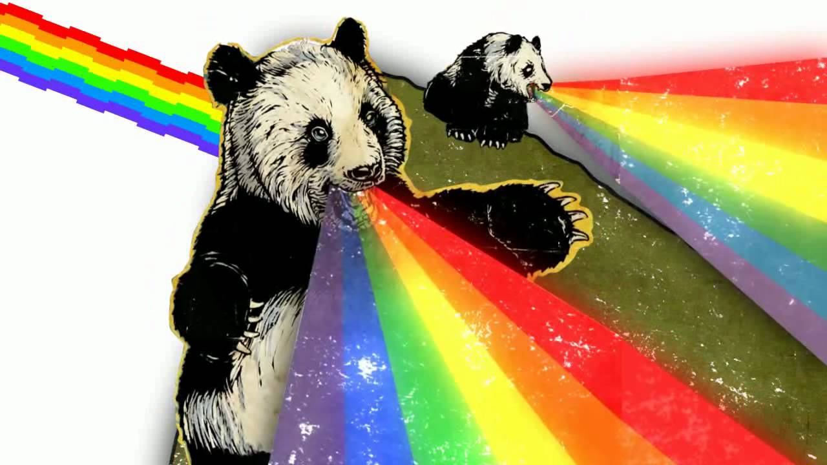
What is github?

Slide 2
Git vs Github?
Github is a service that puts Git in the cloud. That’s it, totally different from… git
Git is essentially “Track changing” in Word (Thanks Kodjo!)
Github.com stores your git information for you, and shares it with your team.

Slide 3
Why do I want to use it?
Writing code = team based activity. Github.com allows for easy collaboration with the team.
Great way to go back and fix stuff
Great way to see productivity
Lots of other features we won’t talk about today

Slide 4
Seems scary
It’s not, because this slide says so☺
Built into OSX (mac) and linux by default
All servers have it built in
All developers should already use it***
Fantastic support/community!

Slide 5
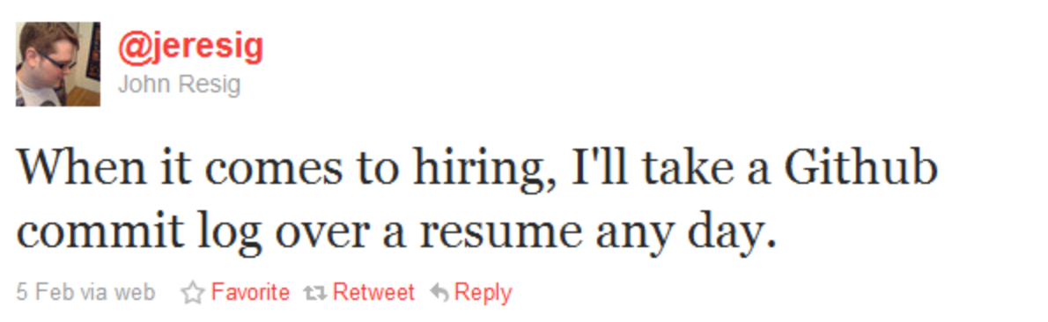
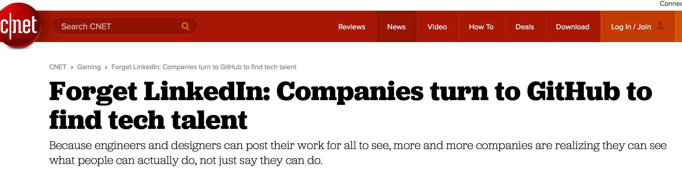

Slide 6
Github.com, vs gitlabs.com, vs bit bucket.com
All the same thing, just different services.
Similar to “starbucks vs pete’s vs dunken donuts” They all sell coffee.
All work pretty much the same
Bitbucket is free though, so FREE!! Weeee

Slide 7
Hands on, lets jump in
Go to www.github.com
For those using windows, Google “Github for desktop” and download it
2 ways to interact w/ git.
- command line
- GUI

Slide 8
What’s a repository (aka. Repo)?
A repository is a group of files that make up a code base.
Think of it as a folder on a computer.
Private vs Public.
One is private to you and your team only. The other one….

Slide 9
Basic features/commands
Git init (get started)
Git add . (add my changes)
Git commit –am “comment goes here” (add a note to my push)
Git push (move from my computer to github)
Git branch (OMG! What’s a bRANcH!)
Git checkout (switch to an old commit or branch).

Slide 10


Slide 11
Git init
This one is pretty straight forward, Git init = git initialize.
This tells git “hey, pay attention to what I’m doing in this folder”.

Slide 12
Git add
This tells git to add all the changes you just made
Command line:
Git add [file name I changed]
Other options:
Git add .
(notice the dot). This tells git “Yo, I changed a lot of files, add them all”

Slide 13
Git commit
A commit is like a “save” point. It’s a point in time that git knows stuff changed.
Good metric of productivity, lots of commits means lots of code that was added (or subtracted)

Slide 14
Commit continued
Example on live repo

Slide 15
Git push
A “push” is when you take a copy of what’s on your computer, and “push” it to github.com.
Why? So everyone else on your team can see what you did. Example:
Keith makes edits to hello.txt
Claire also makes her own edits to hello.txt
Ryan comes in, and adds his own stuff to hello.txt
Now what? Github knows when/where each person made changes and manages them so they work well**

Slide 16
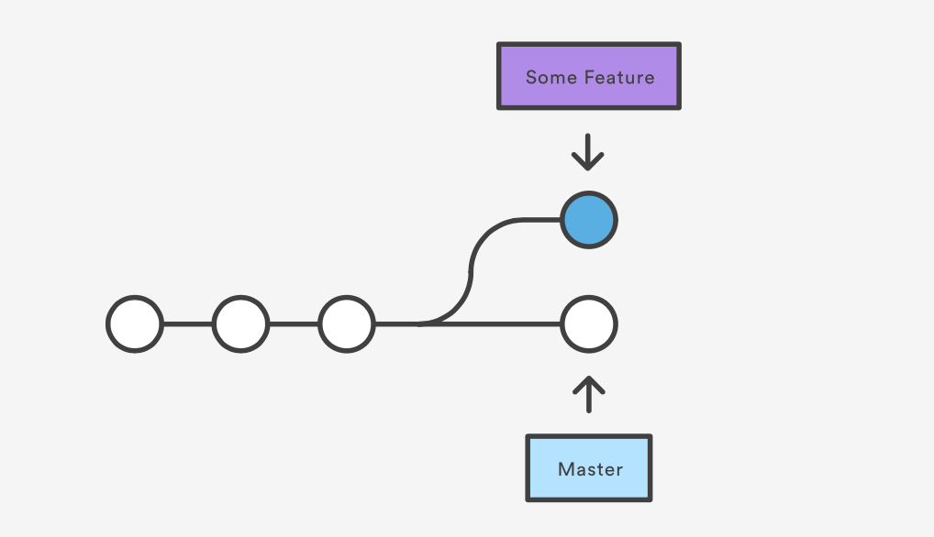
Git branch
Branches are similar to the previous concepts.
Why you branch?

Slide 17
Git merge
Merges changes between branches.
master Branch: Some Feature Branch:
File1.txt
Created by Keith
File1.txt
Edited by Ryan Claire Kodjo
Git merge takes all of Ryan, Claire and Kodjo’s changes into the master branch. Now
File1.txt has everyone’s edits and everyone who is working on this project has the
Exact same version of file1.txt
Imagine this over a few hundred files and a team of 10 people

Slide 18
So much m0ar!
This is 1% of what git (and github) is capable of.
Want to know more? The github documentation is very easy to ready. Just copy/paste what they tell you to do and your good.
Where is the beer?

